Slide 1
16- Swapping Variables

Slide 2
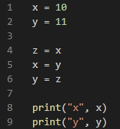


Slide 3
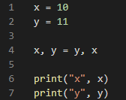

online four, on the right side of the assignment operator, we’re defining a tuple, because in the last lecture I told you that when defining a topple you can use parenthesis or you can exclude the parenthesis. So this code is exactly equivalent to this

Slide 4
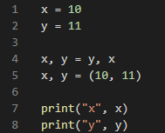
What do we have on line five?
a topple that we're unpacking.
For this very reason, We can define multiple variables on the same line

Slide 5
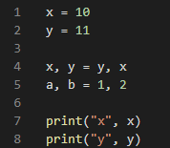
we’re defining a tuple and then unpacking it on the left side.

